Slide 1
GRP-15
Analytical Global Median Filtering Forensics based on Moment Histogram
Digital Image Processing
Vedansh Sharma (12242000)
Shivangi Gaur (12241720)
Shubham Mahajan (12241730)

Slide 2


Introduction & Objective
Goal
Focus Area
Dataset and Parameters
Re-implement pivotal components of the referenced forensic analysis paper using Python.
Exclusively utilize the Skewness-based feature vector (SK) for image forensic feature extraction.
Leverage the UCID dataset with 256×256 and 512×384 resolutions with JPEG compression at quality level 90.

Slide 3
Dataset Acquisition
Source of Data
Preprocessing Steps
The UCID image database, containing natural color images in uncompressed form, was selected for analysis.
Conversion of images to grayscale to standardize input.
Resizing images precisely to two target resolutions: 256×256 pixels and 512×384 pixels.

Slide 4
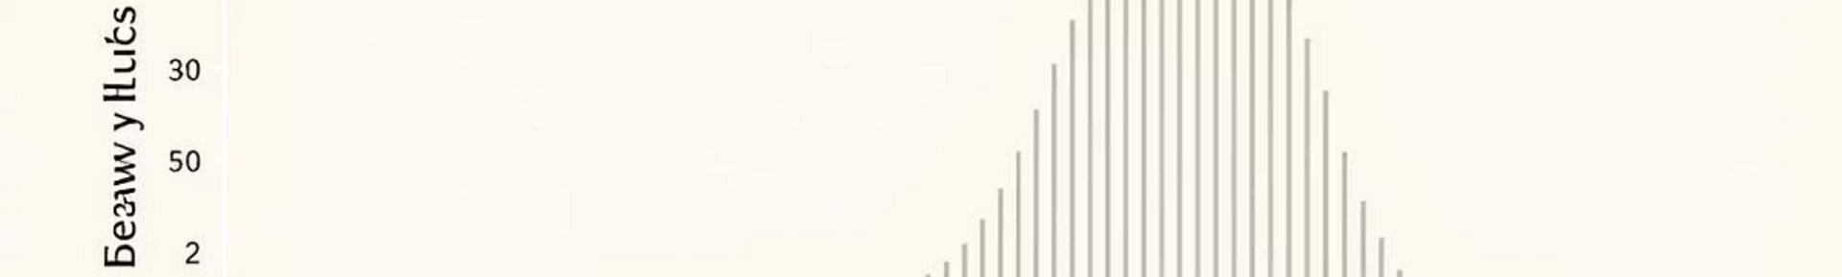





Feature Extraction: Skewness Vector (SK)
Block Division
Images are divided into non-overlapping blocks sized according to resolution to localize features.
Histogram Computation
For each block, intensity histograms are calculated capturing pixel distribution.
Skewness Calculation
Skewness measures asymmetry in the intensity distribution, reflecting subtle image manipulations.
Global Feature Vector
All block-level skewness values are concatenated to form the comprehensive SK feature vector.

Slide 5
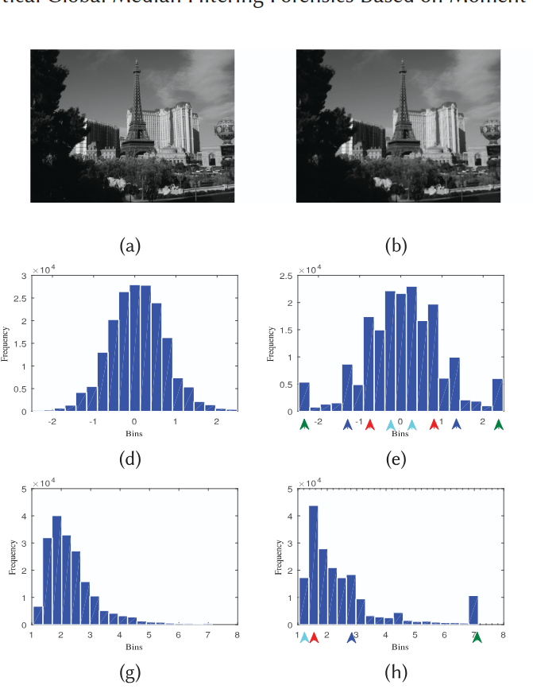
Statistical Foundations: Skewness and Kurtosis
Skewness
Kurtosis
Measures the asymmetry of a probability distribution. Zero indicates symmetry, positive values show right-tailed distributions, and negative values left-tailed ones.
Quantifies distribution peakedness or tail weight. High kurtosis indicates heavier tails (leptokurtic), while lower values indicate lighter tails (platykurtic) or a more flat distribution.

Slide 6
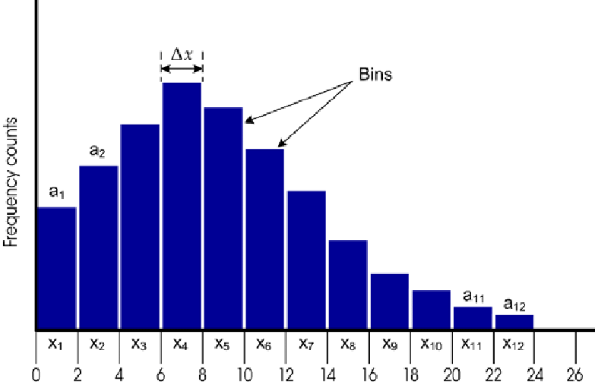
Core Feature Components: Histograms and Moments
Skewness Histogram Bin Heights (SBH)
Kurtosis Histogram Bin Heights (KBH)
Nine bins quantify the frequency of skewness values across blocks. Median filtering reduces distribution asymmetry, altering these frequencies.
Four bins measure the prevalence of kurtosis levels. Filtering tends to amplify peakedness, reflected in elevated counts in specific bins.

Slide 7
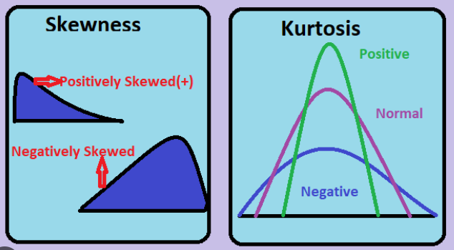


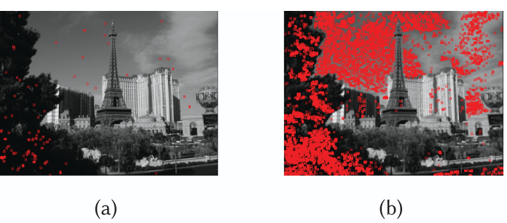
Additional Features: Statistical Moments and Uniform Blocks
Statistical Moments of Skewness and Kurtosis (fMOM)
Four features derived from normalized variance and mean summarize the global shape changes in distributions caused by filtering.
Same Intensity Block (SIB) Count (fSIB)
Counts blocks with identical pixel values; median filtering increases such uniform areas, especially in smooth image regions, serving as a key detection marker.

Slide 8
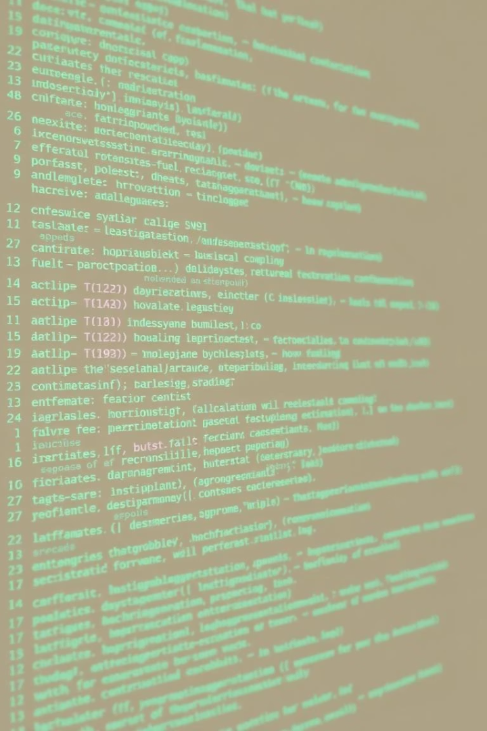
Feature Vector Extraction Approach
1
Step 1: Extract SBH
Compute skewness histograms from block statistics capturing asymmetry changes.
2
Step 2: Extract KBH
Calculate kurtosis histograms reflecting peakedness alterations.
3
Step 3: Compute fMOM
Compute normalized mean and variance for skewness and kurtosis distributions.
4
Step 4: Calculate fSIB
Count uniform intensity blocks, which increase after median filtering.

Slide 9



Performance Advantages and Practical Applications
Robust in Realistic Conditions
Effective despite typical image processing challenges such as compression artifacts and resolution degradation.
Improved Accuracy
2
Outperforms existing methods especially for JPEG compressed and low-res images, reflected by better ROC AUC scores and lower error rates.
1
Wide Forensic Relevance
3
Applicable in digital forgery detection, legal image verification, and media authenticity assessment.

Slide 10
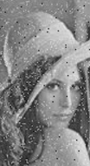
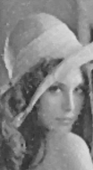
Before vs After
Median Filter
Types of Attacks and Manipulations
Filtering Attacks
Median Filtering
Average Filtering (3×3 kernel)
Median Filtering with 3×3 kernel
Gaussian Filtering
Median Filtering with 5×5 kernel
Resizing via downsampling and upsampling
JPEG Compression at quality 90

Slide 11
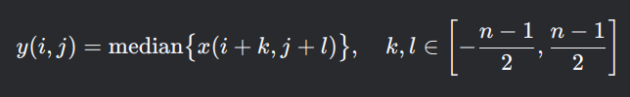
Attacks
Median Filtering
Given a signal or image with values x(i,j) (where i,j are pixel coordinates), the median filter operates over a window (kernel) of size n×n:
where:
y(i,j) = filtered output at position (i,j),
x(i+k,j+l) = pixel values in the neighborhood,
n = window size (typically odd, e.g., 3×3, 5×5).

Slide 12
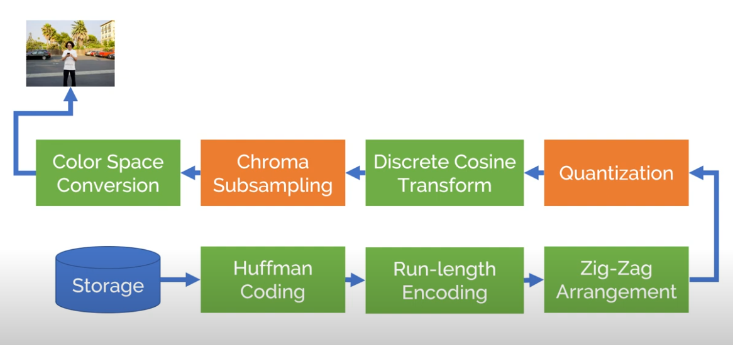
Attacks
JPEG compression
JPEG Compression is a widely used lossy image compression method that reduces file size by discarding high-frequency visual data (less noticeable to the human eye).

Slide 13
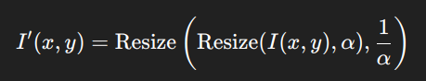
Attacks
Rescaling Filtering
Where:
𝛼 is the rescaling factor (e.g., 0.5 for downscaling, 2.0 for upscaling).
Resize(img, factor) denotes the image resizing operation using a given interpolation method.
In the paper, a rescaling factor of 0.5 (downscaling and then upscaling) is used, implemented with bicubic interpolation.

Slide 14
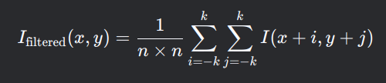
Attacks
Average Filtering
where:
n = kernel size (usually odd, e.g., 3×3, 5×5),
k = (n-1)/2 (half-width of the kernel).

Slide 15
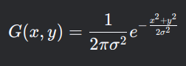
Attacks
Gaussian Filtering
where:
(x,y) = pixel coordinates relative to the kernel center,
σ = standard deviation (controls the spread of the blur),
The kernel is normalized so that the sum of all weights equals 1.

Slide 16


Classification Framework
Classifier Selection
Support Vector Machine (SVM) employed for binary classification between pristine and manipulated images.
We added label as the 20th column in the vector set.
Label 0: orig, jpeg, res, gau, avg
Label 1: mf3, mf5, mf35

Slide 17

SVM Training Methodology
1
Input Features
2
Training Strategy
SK feature vectors derived from both original and attacked images form the input data.
Train individual binary classifiers per attack type to isolate effects and enhance detection accuracy.
3
Kernel Selection
Binary classifier C-SVM is used with cubic kernel function for classification.

Slide 18
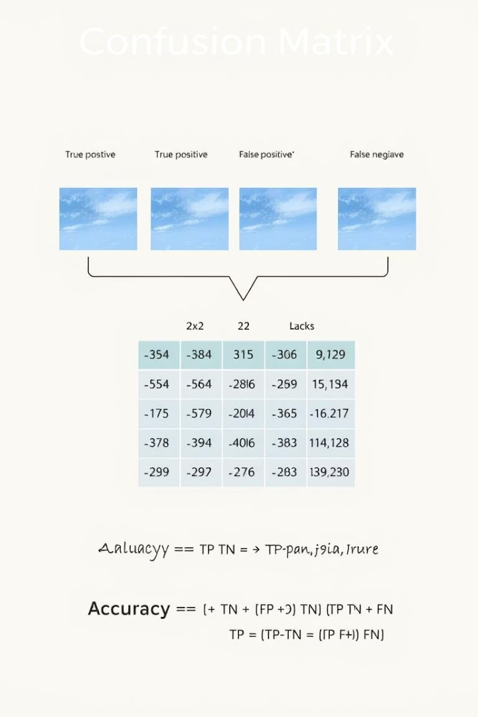




Testing Procedures and Metrics
Rate of error
Area under Curve
Fraction of incorrect predictions made by a model over a dataset.
The lower the better.
Key performance metric in machine learning for evaluating binary classifiers.
The higher the better.

Slide 19
RESULTS

Slide 20
Median Filtering Against Other Manipulations for Varying Resolution Uncompressed Images
 |  |  | MF3 |  |  |  | MF5 |  |  |  | MF35
Implementation | Resolution | Metric | AVG | GAU | JPEG | RES | AVG | GAU | JPEG | RES | ALL
Research paper | 512x384 | Pe | 0.009 | 0.0041 | 0.0078 | 0.0011 | 0.0067 | 0.0019 | 0.0034 | 0.0015 | 0.0075
 |  | AUC | 0.9951 | 0.9986 | 0.9958 | 1 | 0.9981 | 0.9999 | 0.9971 | 1 | 0.9973
Grp-15 | 512x384 | Pe | 0.0075 | 0.0075 | 0.009 | 0.009 | 0.006 | 0.006 | 0.0075 | 0.0075 | 0.0075
 |  | AUC | 0.9952 | 0.9992 | 0.995 | 0.9958 | 0.9949 | 0.9977 | 0.9941 | 0.9953 | 0.9942
Research paper | 256x256 | Pe | 0.006 | 0.006 | 0.0075 | 0.0037 | 0.0022 | 0.003 | 0.0056 | 0.0011 | 0.0101
 |  | AUC | 0.999 | 0.9966 | 0.9957 | 0.9976 | 0.9987 | 0.9991 | 0.9984 | 0.9986 | 0.9954
Grp-15 | 256x256 | Pe | 0.4343 | 0.4388 | 0.4239 | 0.4493 | 0.4358 | 0.4403 | 0.4254 | 0.4507 | 0.4222
 |  | AUC | 0.7434 | 0.7149 | 0.7481 | 0.6095 | 0.8041 | 0.7812 | 0.8179 | 0.6834 | 0.7836

Slide 21
Post JPEG Compressed Median Filtered Images against original images
 |  | ORI vs MF3+Q |  | ORI vs MF5+Q
Implementation | Resolution | Pe | AUC | Pe | AUC
Research paper | 512x384 | 0.0135 | 0.9932 | 0.006 | 0.9956
Grp-15 | 512x384 | 0.2791 | 0.9858 | 0.0657 | 0.9886
Research paper | 256x256 | 0.0594 | 0.9637 | 0.0299 | 0.9825
Grp-15 | 256x256 | 0.5418 | 0.4496 | 0.5269 | 0.42

Slide 22
Median Filtered Images Post JPEG Compressed against Other Manipulations
 |  |  | MF3+Q |  |  | MF5+Q |  |  | MF35+Q
Implementation | Resolution | Metric | AVG | GAU | RES | AVG | GAU | RES | ALL
Research paper | 512x384 | Pe | 0.0105 | 0.0138 | 0.0123 | 0.0071 | 0.0093 | 0.0056 | 0.0179
 |  | AUC | 0.994 | 0.9901 | 0.9909 | 0.9958 | 0.9934 | 0.9961 | 0.9882
Grp-15 | 512x384 | Pe | 0.2776 | 0.2776 | 0.2791 | 0.0642 | 0.0642 | 0.0657 | 0.0479
 |  | AUC | 0.9579 | 0.9908 | 0.9883 | 0.9849 | 0.993 | 0.9898 | 0.9891
Research paper | 256x256 | Pe | 0.0213 | 0.0389 | 0.0426 | 0.0265 | 0.0176 | 0.0217 | 0.0407
 |  | AUC | 0.9884 | 0.9791 | 0.975 | 0.98 | 0.9875 | 0.9852 | 0.9754
Grp-15 | 256x256 | Pe | 0.5015 | 0.506 | 0.5164 | 0.4866 | 0.491 | 0.5015 | 0.482
 |  | AUC | 0.6482 | 0.6157 | 0.492 | 0.6078 | 0.5775 | 0.4598 | 0.5922

Slide 23
Post JPEG Compressed Median Filtered Images Against Post JPEG Compressed Original Images
 |  | ORI+Q vs MF3+Q |  | ORI+Q vs MF5+Q
Implementation | Resolution | Pe | AUC | Pe | AUC
Research paper | 512x384 | 0.0086 | 0.9962 | 0.003 | 0.9994
Grp-15 | 512x384 | 0.2791 | 0.9647 | 0.0657 | 0.9855
Research paper | 256x256 | 0.0116 | 0.994 | 0.0037 | 0.9981
Grp-15 | 256x256 | 0.491 | 0.6504 | 0.4761 | 0.6082

Slide 24
Contributions
Shivangi
Processed Median Filtering (MF3, MF5, MF35), Average Filtering (AVG)
SK Feature Extraction for above manipulations
Shubham
Processed Gaussian Filtering (GAU), Rescaling (RES), JPEG Compression
SK Feature Extraction for above manipulations
Vedansh
SVM Model Training & Testing
Evaluation Table Construction & Analysis

Slide 25
THANK YOU
Group-15:
Vedansh Sharma (12242000)
Shivangi Gaur (12241720)
Shubham Mahajan (12241730)

